Slide 1


Mini Project “GUARD TALK“ (Secure platform for communication)
Dept. of CS&E ( DATA SCIENCE)
Adichunchanagiri Institute of Technology
Chikkamagaluru - 577102
Presented By,
Bhoomika Gowda H G (4AI22CD008)
M M Bhavya (4AI22CD031)
Meghana N.S (4AI22CD034)
Rishitha N (4AI22CD043)
Under the Guidance of
Prof. Shalini I S

Slide 2
PROBLEM STATEMENT
To design and develop a Chat Application (GUARD TALK), a system that facilitates real-time communication between two users, while ensuring an absolute, secure, and scalable experience. It can deliver a , secure, and scalable solution that provides a smooth and engaging user experience.

Slide 3
SCOPE OF THE PROJECT
In Scope:
Real-time messaging between two users in a secure environment.
User registration and authentication.
Message starring and storage in an Excel file.
Automatic deletion of messages after a specified period or user navigate away from chatting page.
Out of Scope:
Security: Ensures that user data and messages are secure.
Scalability: The system can accommodate only a two users without sacrificing performance.
Usability: An easy-to-use interface for users to send/receive messages through an interaction.
Message Expiry Feature: Messages can automatically expire, keeping
the page clean and efficient.

Slide 4
PROJECT DESIGN
System Components:
Frontend: Built using Flet (Python framework) for interactive and responsive UI.
Backend: User management and message storage logic.
Database: Using an Excel sheet to store starred messages.
Real-Time Communication: Using the Pub/Sub model for broadcasting messages.

Slide 5
Architecture
User Interface: Sign in, sign up, chat interface.
Message Handling: Sending, receiving, starring, and message expiration.
Database Management: Storing starred messages in an Excel sheet.
Backend: Logic to handle user authentication, message storage, and expiration.

Slide 6
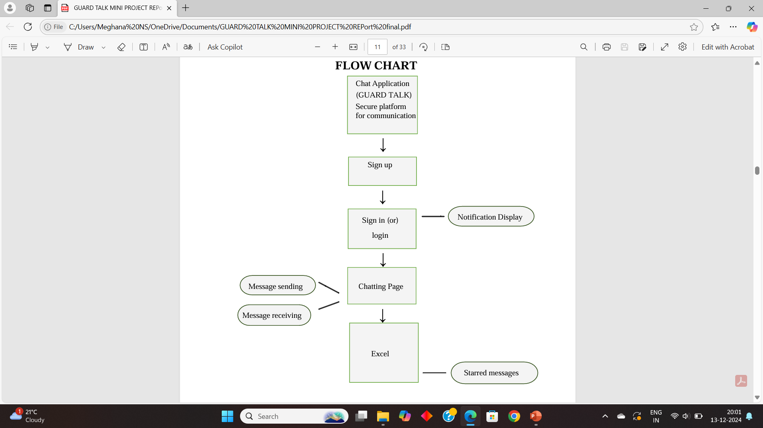
ARCHITECTURE DIAGRAM

Slide 7
METHODOLOGY
Steps/Approach:
User Registration and Login:
Users sign up or log in using credentials like name and password.
Real-Time Messaging:
Messages are sent in real-time, with instant updates to users.
Message Starring and Storage:
Users can star important messages, which are saved to an Excel file.
Message Expiration:
Messages expire after a certain period or when the user logs out.

Slide 8
Tools and Technologies Used:
Flet Framework for real-time messaging UI.
Python for backend logic and server-side processing.
Openpyxl for managing starred messages in Excel.
SQLite/Excel for user and message storage.
Pub/Sub model for real-time communication

Slide 9
IMPLEMENTATION
Code Highlights:
Message Class: Manages the attributes of each message (user, text, starred status).
ChatMessage Class: Controls the layout of individual messages and the interaction (starring and un-starring).
Excel Integration: Code to save and update starred messages in an Excel file.
Message Expiration: Logic to delete messages after a certain time or when a user logs out.

Slide 10
Frontend Implementation:
• main.py:
This is the main entry point for the application. It defines several functions for handling user interactions and manages the application state.
• sign_in and sign_up:
These functions call the corresponding methods in UsersDB to authenticate users. Upon successful login, it sets a user session and redirects to the chat view.
• on_message:
This function handles incoming messages received through the Flet pub/sub mechanism. It renders the message based on its type (chat message or login message).
• send_message_click:
This function sends the user's message through the pub/sub channel.
• toggle_star:
This function toggles the starred state of a message and updates the
starred message list (stored in a global dictionary starred_messages).

Slide 11
Backend Implementation:
This file defines a class UsersDB that simulates a user database. It contains a list of dictionaries representing users with their usernames and passwords.
read_db: This function checks if a given username and password combination exists in the users_list. It returns True if a match is found, False otherwise.
write_db: This function adds a new user with the provided username and
password to the users_list. It returns True if successful.

Slide 12
save_to_excel:
This function by default saves starred messages of a user to an Excel file with their name.
signin_form.py and signup_form.py:
These files define reusable user controls for the sign-in and sign-up forms. They handle user input, validation, and call the appropriate functions in main.py to submit the form.

Slide 13
RESULTS
Secure User Authentication:
Users can sign up, log in, and access personalized chat experience securely.
Passwords are securely handled in the backend.
Real-Time Communication:
The chat application supports real-time messaging between users.
Messages are sent instantly and visible to both the users.
Message Star Rating Feature:
Users can star messages for easy access to important or favorite messages.
Starred messages are saved and can be accessed even after logging out.
Message Expiration Mechanism:
Messages automatically deleted after the user exit, ensuring data cleanliness.
Data Persistence:
Starred messages are stored in Excel files for each user, ensuring data persistence across sessions.
User Experience:
Smooth and engaging interface with emoji dropdown and intuitive message input.
Functional UI for both sign-in and sign-up processes.

Slide 14
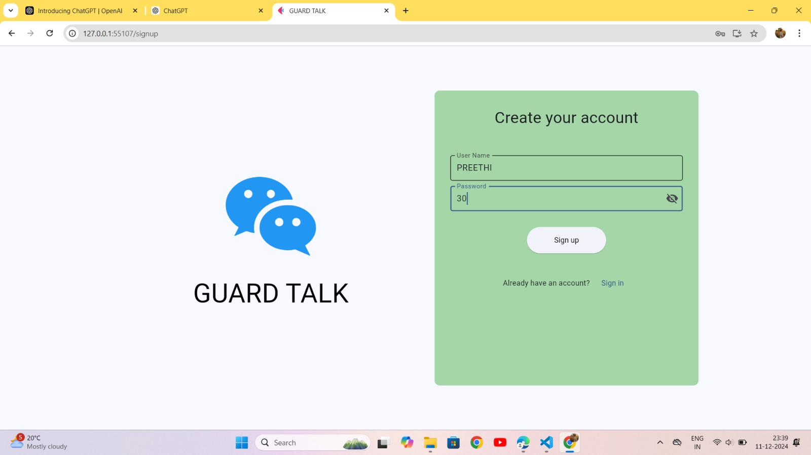
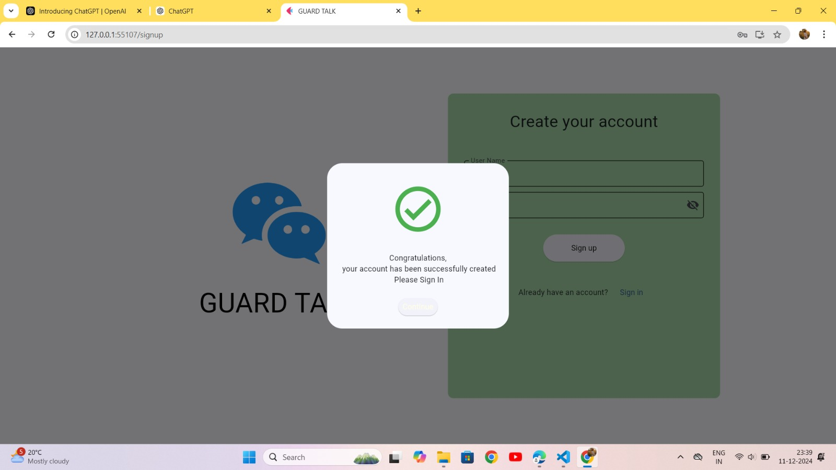
Fig 1: Sign up
Fig 2: Creating an account

Slide 15
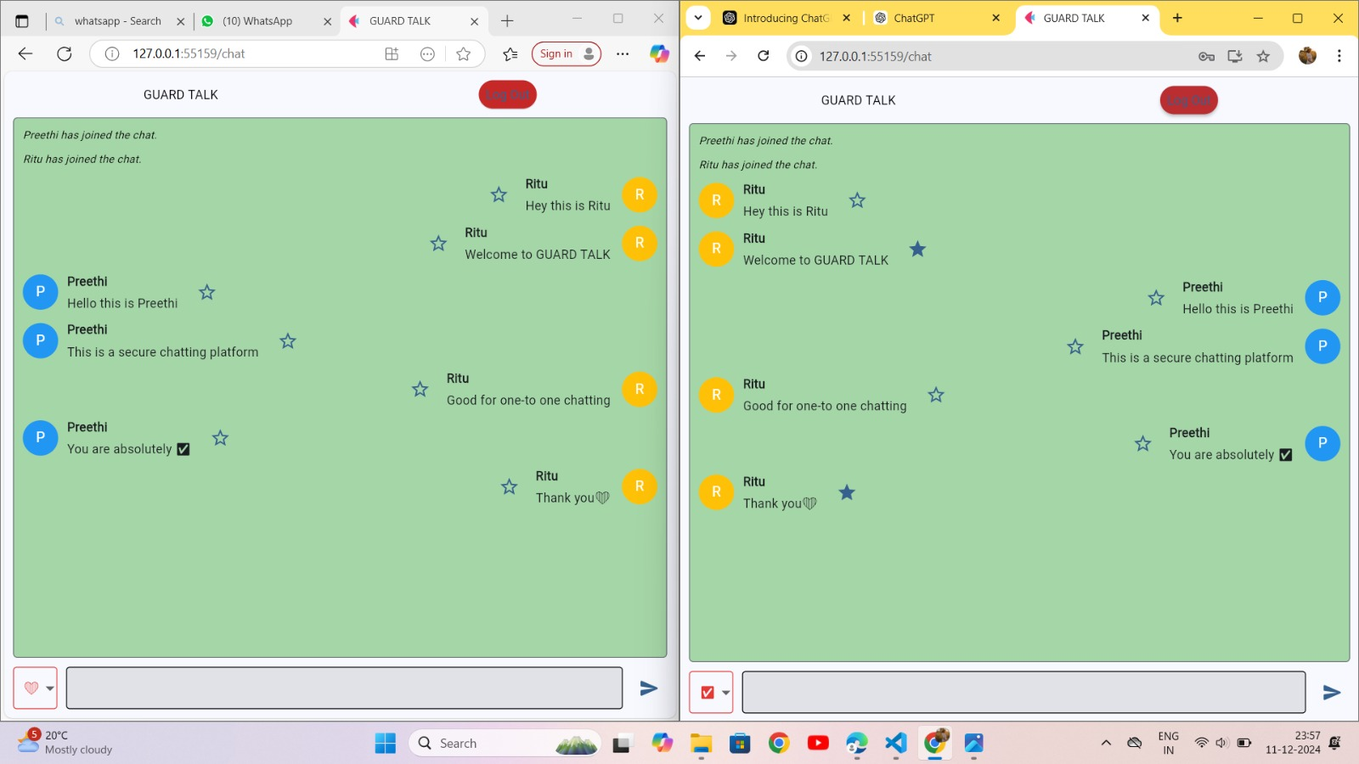
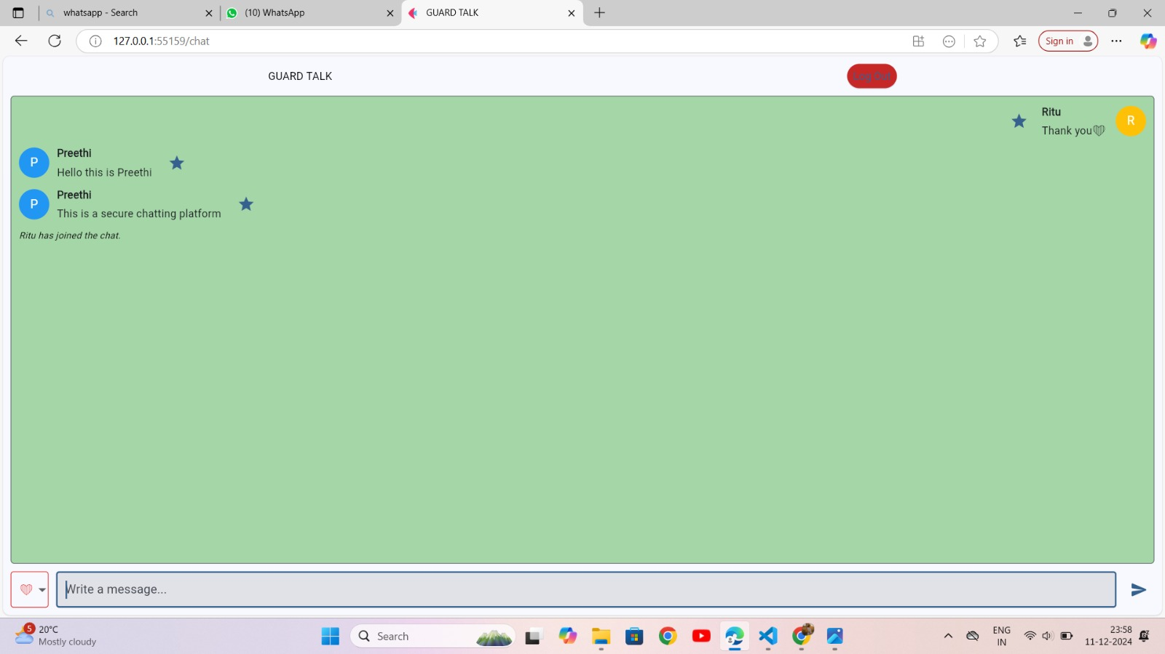
z
Fig 3: Chatting page Fig 4.Starred messages

Slide 16
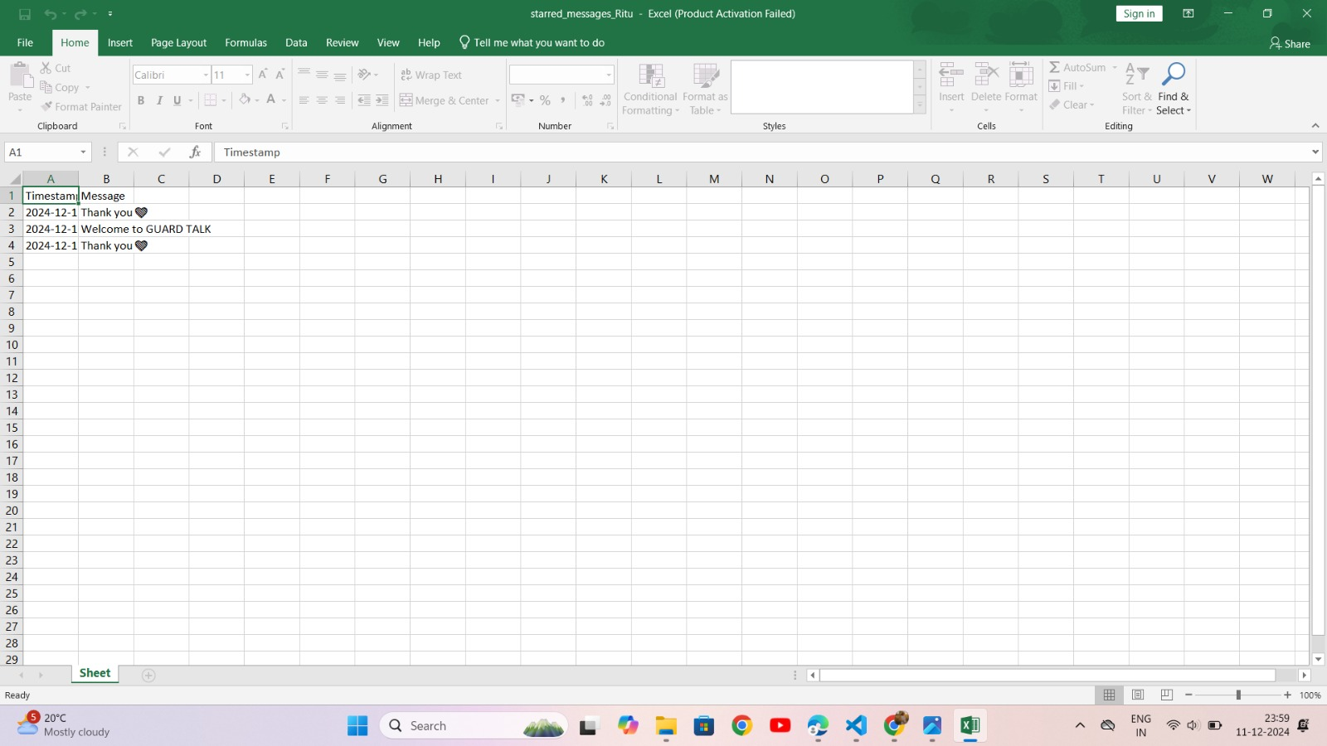
Fig 5: Saving the starred messages in Excel

Slide 17
CHALLENGES FACED
Challenges:
Real-Time Message Delivery: Implementing an efficient and fast system for real-time message broadcasting.
Message Expiration: Ensuring messages are deleted on time, particularly when handling two users.
Data Integrity: Managing the consistency of starred messages and ensuring they are saved correctly in the Excel sheet.
Resolutions:
Used Pub/Sub model for fast message delivery and real-time updates.
Implemented background tasks to manage message expiration after a set period.
Used Openpyxl to efficiently manage data and ensure data integrity in the Excel file.

Slide 18
CONCLUSION
Developed a secure, scalable real-time messaging one to one communication system with features like message starring and expiration.
Addressed key challenges related to real-time communication, data integrity, and message expiration.
A fully functional chat system ready for future enhancements like multi-device support and improved security features.
This project demonstrates the potential of building real-time communication
systems that are both scalable and secure, making it suitable for various
use cases, including enterprise and personal communication.

Slide 19
FUTURE WORK
.
Multi-device Support: Allowing users to access their messages across multiple devices.
Push Notifications: Adding push notifications for new messages when users are not active on the app.
Voice and Video Calls: Integrate real-time voice and video calling capabilities for richer communication.
Offline Messaging: Store and deliver messages to users even when they are offline, ensuring uninterrupted communication.
Plan to integrate End-to-End Encryption for enhanced security of user data and messages.
Excel to power Bi Integration: Seamlessly connect Excel Spreadsheet to Power BI to analyze and visualize numerical data such as message activity, user engagement and system performance matrics.

Slide 20
GIT HUB LINK
Bhoomika Gowda H G: bhoomikagowdahg/Guard-Talk-Project
M M Bhavya : bhavyamm1/Mini-Project
Meghana N S : NSmeghana27/Guard-Talk-Project
Rishitha N : RishithaN11/Mini-Project

